Slide 2
Event extraction
1|

Slide 3

Event extraction: Framework and challenges

Slide 4
Event extraction
Types of event extraction:
CLOSED-DOMAIN EVENT EXTRACTION
OPEN-DOMAIN EVENT EXTRACTION

Slide 5
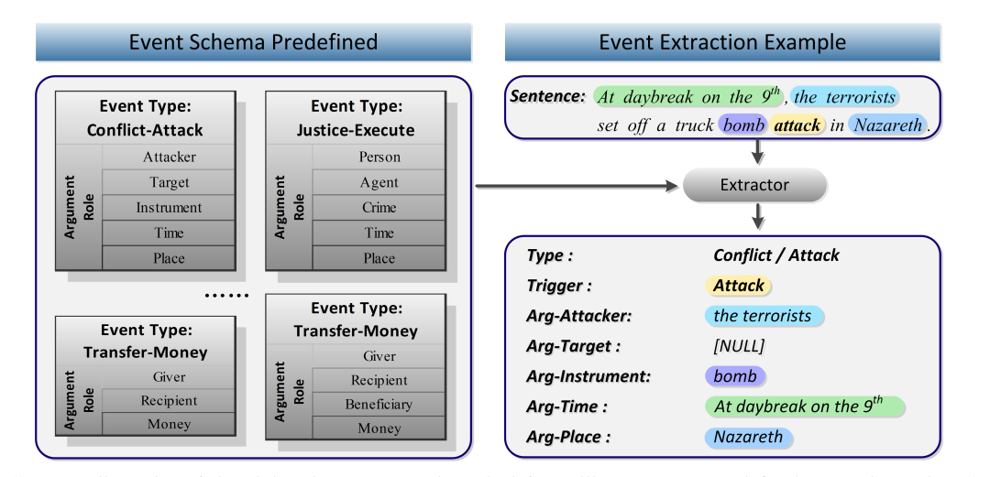
Event extraction
CLOSED-DOMAIN EVENT EXTRACTION

Slide 6
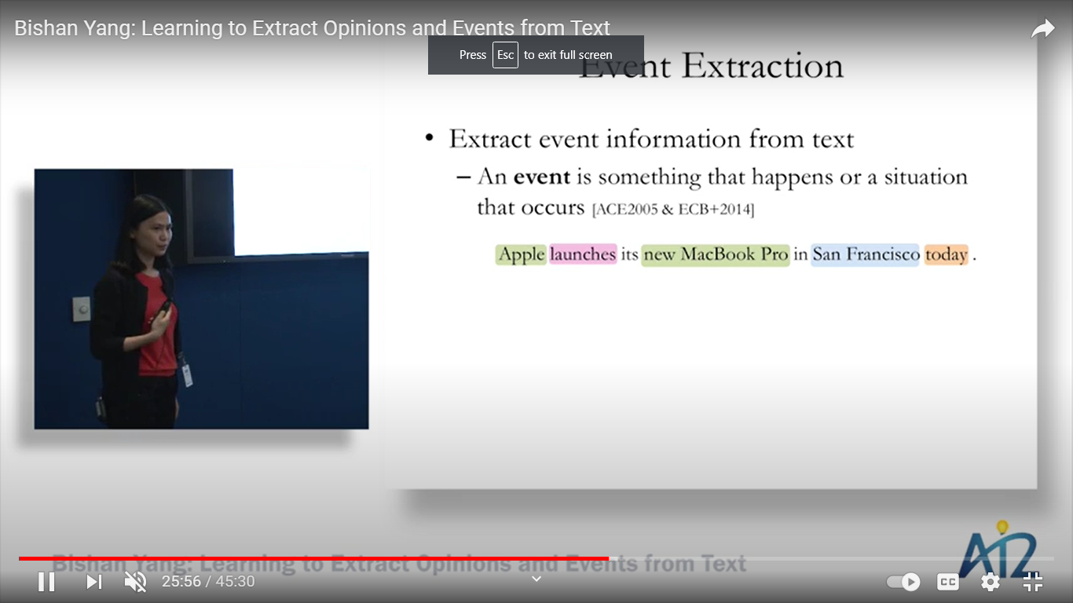
Event extraction
Event Frame Prototype:
Trigger
Source
Target
Time &/ Location

Slide 7
Event extraction
event-related information from the text, such as the "5W1H" about an event (i.e., who, when, where, what, why and how)

Slide 8
Event extraction
Event detection tasks:
TI: Trigger Identification
TC: Trigger Classification within a predefined event classes:
In our case we will centralize our focus on finance-news related events, for instance:
Role identification
event argument detection
argument role identification

Slide 9
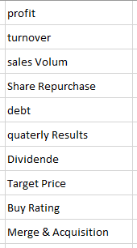
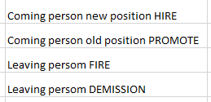

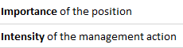
Event Classes for News-related Financial Topics
Topic
Financial performance
HR - Management
Event

Slide 10
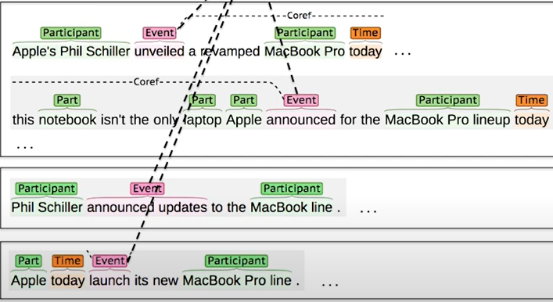
Event extraction - additional steps:
Event Aggregation
The mission of identifying the identical events even if they’re having a different components.

Slide 11
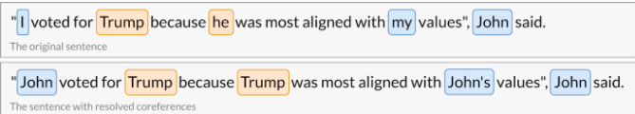
Event extraction – Challenges
Co-reference resolution
Identifying the true reference of a word.

Slide 12
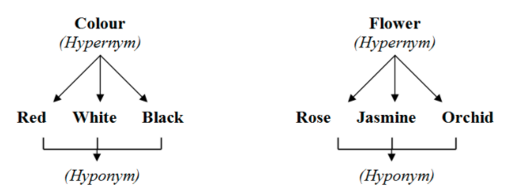
Event extraction – Challenges
Hyponyms & Hypernyms
Avoid redundancy and thus sparsity and complexity.
Avoid polysemy and thus assure a better TC task.

Slide 13
Event extraction – Challenges
Feature extraction process:
Basic approach
Neural Network- based approach

Slide 14
Event extraction
OPEN-DOMAIN EVENT EXTRACTION
Use of keywords to detect each event

Slide 15

FINAL TEXT
Thanks

